Slide 1
Basic Image Analysis (using ImageJ/FIJI)
Christian “Tischi” Tischer
tischitischer@gmail.com
Advanced Light Microscopy Facility (ALMF)
European Molecular Biology Laboratory (EMBL), Heidelberg, Germany

Slide 2

Why ?
Fiji is just ImageJ (bundled with many Plugins)
Free, open-source, wide-spread
Visualization, analysis, automated analysis, 2-D and 3-D
Best software for interactive image inspection and analysis
However, complex workflows and batch analysis require scripting…

Slide 3
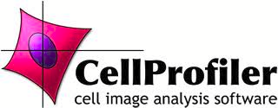
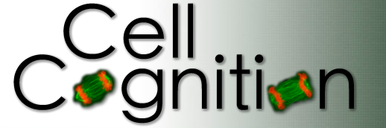
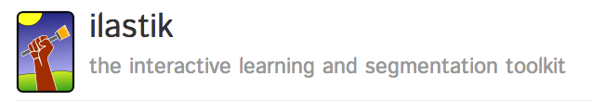
Other free, open-source software
Batch analysis of 2-D data
Good object-logic
Dedicated to batch analysis with 2-D cell-classification and tracking
Does not support intensity quantification
3-D pixel- and object-classification and tracking
Batch analysis?

Slide 4
ImageJ/Fiji Installation
Download from internet: http://fiji.sc/
Recommendations:
For Windows don’t install in the Program Files folder but rather have the Fiji.app folder on the Desktop (due to User rights issues)

Slide 5
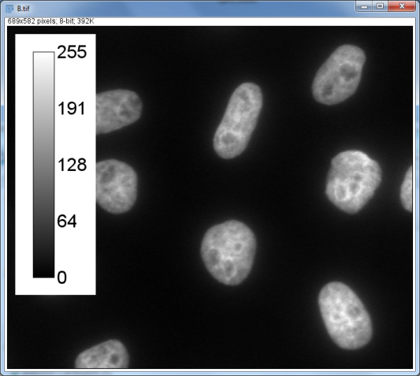
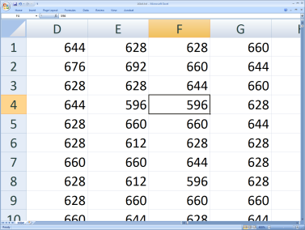
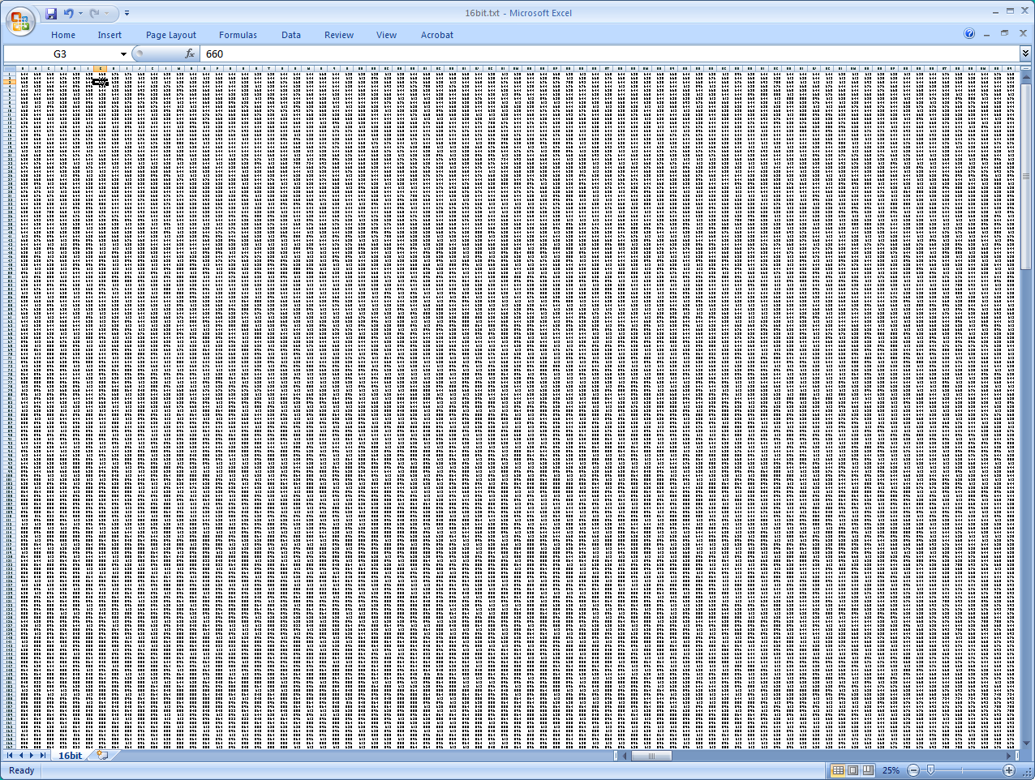
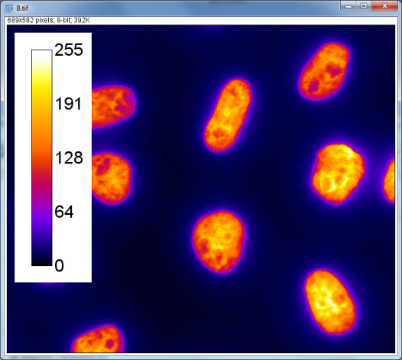
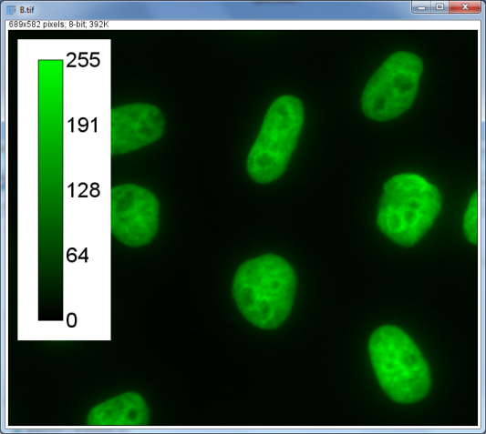
An image is a matrix of numbers
“Grays”
Lookup Table (LUT)
“Fire”
“Green”
8-bit: 0,1,..,255 (2^8 - 1)
12-bit: 0,1,..,4095 (2^12 - 1)
14-bit: 0,1..,16383 (2^14 - 1)
16-bit: 0,1,..,65535 (2^16 - 1)

Slide 6
White-board session on content of microscopy images
Bit depth
Saturation
Offset
Dynamic range

Slide 7
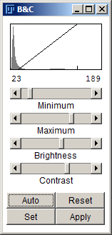
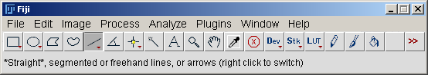
Image data inspection
Mention:
Image..Transform..Image to Results
Open “../dynamic-range/A.tif” (File..Open)
Also open B.tif, C.tif, D.tif, E.tif
Use below methods (M1,M2,M3) to answer Question 1
M1: Adjust the display (Image..Adjust..Brightness/Contrast)
M2 :Examine gray values in whole image (Analyze..Histogram)
M3: Analyze gray values along a line (Analyze..Plot Profile)
Question 1:
which of the images is best described by:
no_problem, high_offset, low_offset,
low_dynamic_range , or saturation ?
Optional Task 1:
Mouse Over
Line Profile
Histogram
HiLo Lookup Table
Image..Transform..Image to Results
Optional Task 1: find (up to five) different ways of checking whether an image contains saturated pixels
Optional Task 2: modify the good_dynamic_range image such that it contains the same values as the high_offset image (Process..Math )
Optional Task 2:
divide by 2
add 120
Notes:
Related functionality: [Image..Transform..Image to Results]; [Analyze..Tools..Calibration bar]
Optional Task 1: Answers: Mouse Over, Line Profile, Histogram, HiLo LUT, Image..Transform..Image to Results
Optional Task 2: divide by 2 and then add 120
7

Slide 8
Image data presentation
[File > Open] “../image-presentation/*.*”
[Analyze > Tools > Calibration Bar]
[Image > Color > Merge Channels]
[Analyze > Tools > Scale Bar]
Positive
control
Negative
control
[Image > Adjust > Brightness&Contrast]
[Set] “Propagate to all other open images”

Slide 9
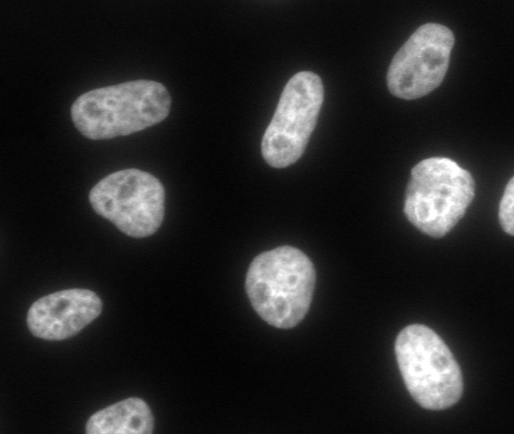
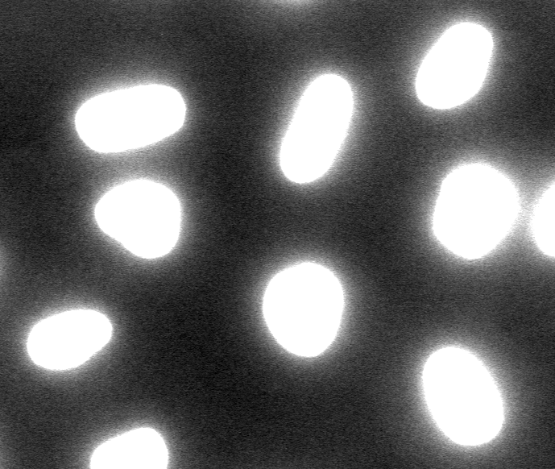
Image format conversion
open “../bit-conversion/16bit.tif” (File..Open)
Adjust the display that you actually see something
adjust Jpeg quality (0-100) to 10 (Edit..Option..Input/Output)
save as Q10.jpg (File..Save As..Jpeg)
repeat the last 3 steps for Jpeg qualities 75, and 100
save as im.png (File..Save As..PNG)
adjust the display such that the nuclei are saturated (Image..Adjust..Brightness/Contrast)
save as Q100_saturated.jpg (File..Save As..Jpeg)
save as im_saturated.png (File..Save As..PNG)
Q10.jpg
Q75.jpg
Q100.jpg
im.png
Q100_saturated.jpg
im_saturated.png
Task 1: compare the sizes of these files!
Task 2: compare the content of the images! (you have to re-open the saved images!)
Notes:
Note: every year the outcome of this practical changes, showing how dangerous it is to save images in different formats (if you still want to quantify them).

Slide 10
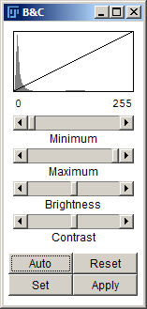
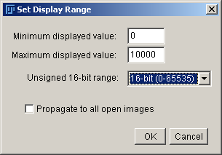
Conversion to 8-bit format
Open “../bit_conversion/16bit.tif”
examine the gray values using for instance: Analyze..Histogram or Analyze..Plot Profile
Duplicate the 16bit image (Image..Duplicate) perform the next steps on the duplicated image!
change display using: Image..Adjust..Brightness/Contrast..Set
convert to 8-bit: Image..Type..8-bit
examine the gray values, using for instance: Analyze..Histogram or Analyze..Plot Profile
Question 1: how do the set Minimum & Maximum values influence the 8-bit conversion? (Tip: Repeat steps 3.-5. using different values for “Minimum & Maximum displayed value” and use the methods that you learned to examine the pixels values!)
Question 2: what are the best displayed Minimum & Maximum values for a “good 8-bit conversion”?
Notes:
Answer 1: The minimum displayed value will be set to 0 and the maximum displayed value will be set to 255 in the final 8 bit image.
Answer 2: There is no easy answer => better avoid conversions!

Slide 11
Measuring signal to noise
Signal
Noise
Nucleus 2
Signal
Noise
Nucleus 1
Signal
BG
Noise
Signal to Noise = (Mean(Object)- Mean(BG)) / Sqrt(Sdev(Object)^2+Sdev(BG)^2)
Nucleus 1: 4.7
Nucleus 2: 2.0

Slide 12
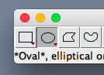
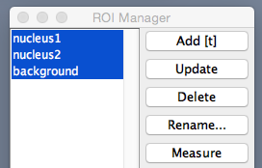
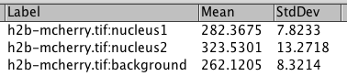
Measure signal to noise
[File > Open] “../signal-to-noise/h2b-mcherry.tif”
[Analyze > Set Measurements] “Mean gray value”, “Standard deviation”
Draw region as shown using the “Oval Selection”
Save region [Analyze>Tools>ROI Manager>Add]
Name region [Analyze>Tools>ROI Manager>Rename]
Select all regions and measure [ROI Manager>Measure]
Apply formula to measure a S/N ratio: [Mean(Signal)-Mean(BG)] / Sqrt[Sdev(Signal)^2 + Sdev(BG)^2]
Notes:
Answer 1: The minimum displayed value will be set to 0 and the maximum displayed value will be set to 255 in the final 8 bit image.
Answer 2: There is no easy answer => better avoid conversions!

Slide 13
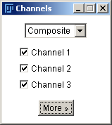
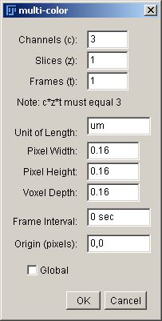
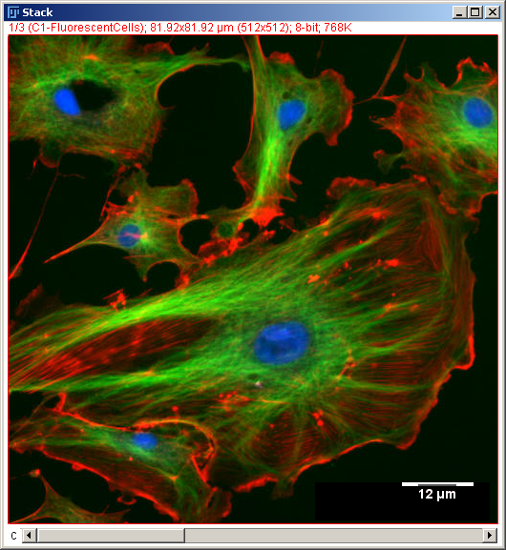
multi-color and scale-bar
open all images in “../multi-color/” [File..Import..Image Sequence]
convert to a “Composite Image” [Image..Color..Make Composite]
open the “Channels Tool”: [Image..Color..Channels Tool]
change channel colors [Image..Lookup Tables..]
you have to move the channel slider (see screenshot below)
change scaling to 0.16 um [Image..Properties]
add scale bar [Analyze..Tools..Scale Bar]
Activate the Overlay checkbox
save image twice:
[File..Save As..Tiff]
[File..Save As..Jpeg]
open both in PowerPoint and compare
reopen both in Fiji and compare
Aim: the image should look like this
Optional task 1: try making the nucleus appear brighter and the microtubules dimmer
slider to select active channel!
Notes:
Task 1: select the respective channel and change appearance with [Image..Adjust..Brightness/Contrast]

Slide 14
always keep your raw images! (do conversions only on duplicates!)

Slide 15
Measurements in images
These days, for scientific publications, it is typically not enough to just show “representative images” but you need to provide measurements and statistics!
In the following we will practice how to extract meaningful numbers from images.

Slide 16
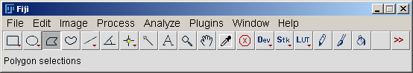
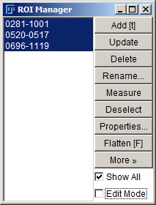
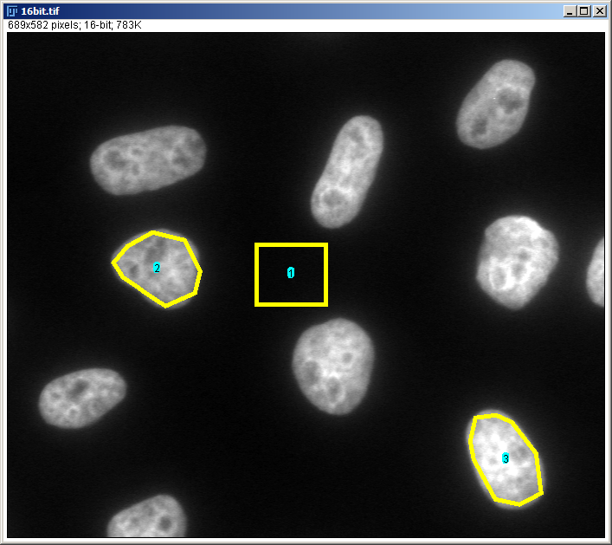
Manual measurements in multiple regions
Question: how much brighter is nucleus 1 than nucleus 2?
Optional Task: measure the area of all nuclei (which one is the largest)?
open “../bit-conversion/16bit.tif”
draw region for Nucleus 1 as shown below using the Polygon Selection
save the region (Analyze..Tools..ROI Manager..Add)
name the region “Nucleus 1” (Analyze..Tools..ROI Manager..Rename)
Repeat above steps for Background and Nucleus 2
select “Mean Gray Value” measurement (Analyze..Set Measurements)
Select all regions and measure (ROI Manager…Measure)
Background
Nucleus 2
Nucleus 1
Notes:
Useful: [ROI Manager..More..Labels] => shows the names on the image

Slide 17
Biological interpretation of intensity measurements
Intensity measurements are a difficult thing, because there are many (technical) factors that can influence the intensity in an image. This topic is almost another course and should be (also) taught at the microscope…
In addition, even if microscopy and sample preparation were performed perfectly (settings, controls, etc…), and you saved your images properly, one still needs to understand what a certain intensity readout means!
=> Whiteboard session (or show slides from other talk) on difference between widefield vs. confocal acquisition and mean vs. total (sum) intensities.

Slide 18
16-bit (or 8-bit) vs. 32-bit images
open “../bit-conversion/16bit.tif” [File>Open..]
Duplicate raw data [Image>Duplicate..]
Subtract 800 gray [Process>Math>Subtract..]
Compare gray values before and after subtraction! Do you observe something mathematically wrong?
Duplicate raw data [Image>Duplicate..]
Divide by 2 [Process>Math>Divide..]
Compare gray values before and after subtraction! Do you observe something mathematically wrong?
Check how above subtraction and division changes when you convert the image to 32-bit beforehand [Image>Type>32-bit]
Take home message: before doing any math to your image, convert to 32bit

Slide 19
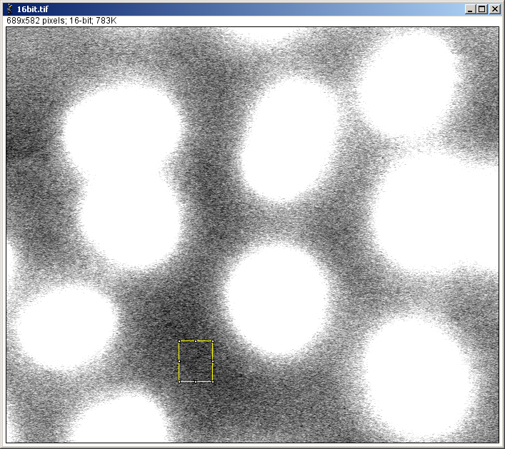
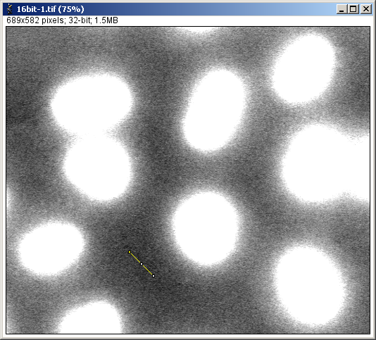
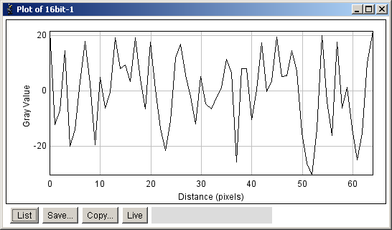
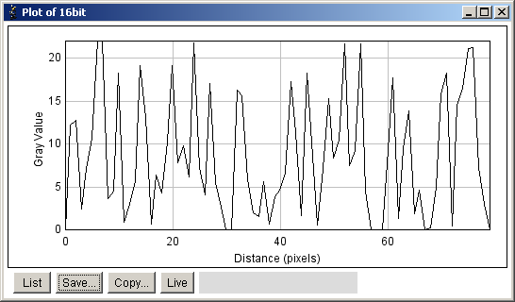
Manual background subtraction on an image
Open “../bit_conversion/16bit.tif”
Convert image to 32-bit: [Image..Type..32bit]
This allows for negative numbers in the image
Draw ROI in the BG
Increase brightness a lot to see whether it really is BG
Select measurement “Mean Gray Value” [Analyze..Set Measurements]
Measure BG intensity [Analyze..Measure]
Remove the BG ROI [Edit..Selection..Select None]
Subtract BG intensity [Process..Math..Subtract]
Put back BG ROI [Edit..Selection..Restore]
Now measure BG intensity again [Analyze..Measure]
You should get zero ☺
Repeat everything but leave the image 16bit (do not convert to 32bit)
The resulting BG intensity should not be zero ☹
Notes:
You have to remove the BG ROI before the subtraction, because otherwise ImageJ only subtracts the value from this region.
If you don’t convert to the image to 32bit there can be no negative numbers and thus the background subtraction does not work properly…

Slide 20
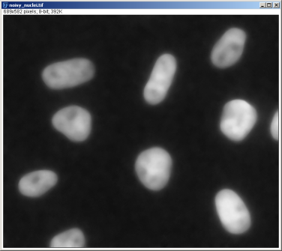
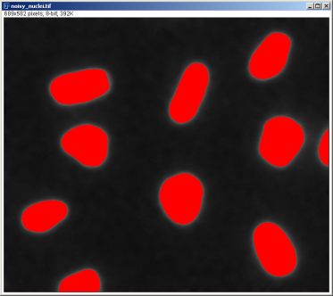
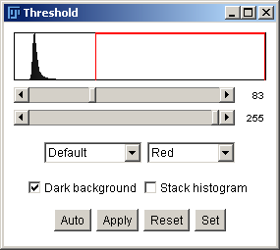
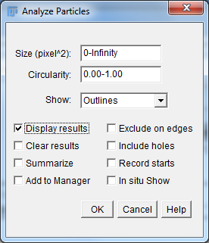
Threshold and automated particle analysis
open image “../dynamic-range/B.tif”
Select the measurements you want to extract (e.g., “Area” and “Shape descriptors”):
[Analyze..Set Measurements]
Threshold the image (Image..Adjust..Threshold)
Only move the upper slider (lower should be on 255)
Do NOT press Apply; simply leave the Threshold dialog open
Detect & measure the objects (Analyze..Analyze Particles)
“Show: Overlay Outlines”
“Select: Display Results”
Question 1: what is the average size of the nuclei?
Question 2: how can you exclude nuclei that are not fully in the image?
Optional Task 1: Examine the Results table and find values for the Size- and Circularity-Filter in Particle Analyzer such that some Nuclei are excluded.

Slide 21
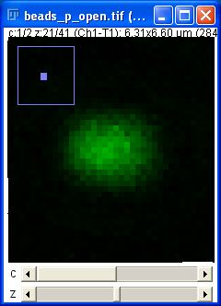
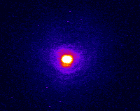
Point Spread Function Examination
Open “../psf/beads_p_close.tif” (File..Open)
Hyperstack: two channels: green (c1) and red (c2) bead
Generate side views (Image..Stacks..Reslice)
Do NOT avoid interpolation
Project into 2-D (Image..Stacks..Z-Project)
Projection Type: Sum Slices
Repeat above steps for “../psf/beads_p_open.tif”
This is a “hyperstack”,
containing a channel-
and a z-slider
Question: What is the difference between open and closed pinhole?
Optional Task 2: Generate above movie
- File..Open
Image..Color..Split channels
Image…Lookup Tables..Fire
- Image..Stacks..3D Project (interpolate)
Optional Task 1: Compare the apparent width of green and red bead (in the xy-direction). Choose a central z plane in the original file and:
Analyze..Plot Profile
Analyze..Tools..Curve Fitting (gaussian)
- copy the list from the profile plot into the fitting tool
Notes:
Optional Task 1:
21

Slide 22
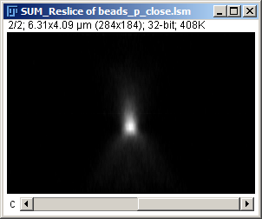
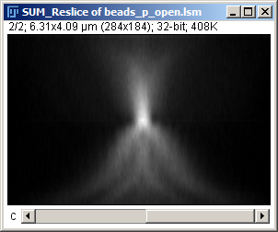
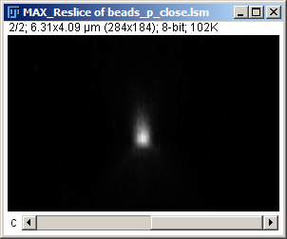
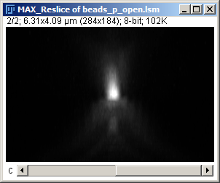
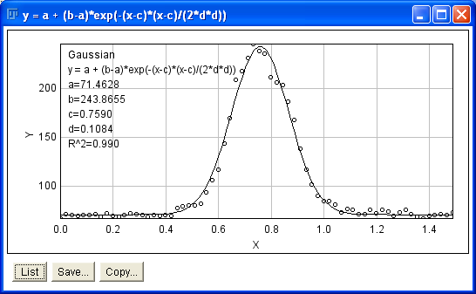
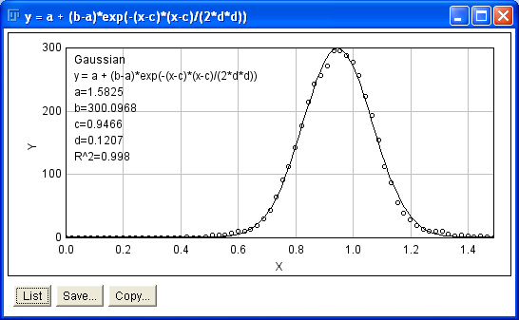
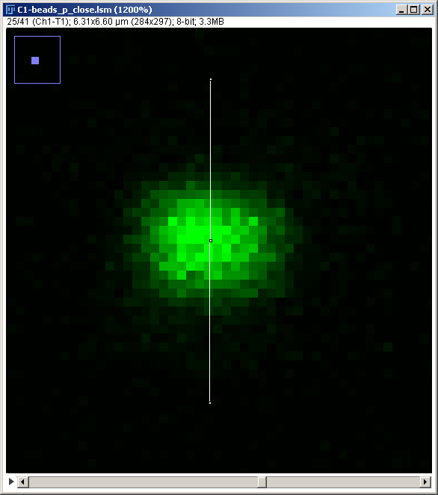
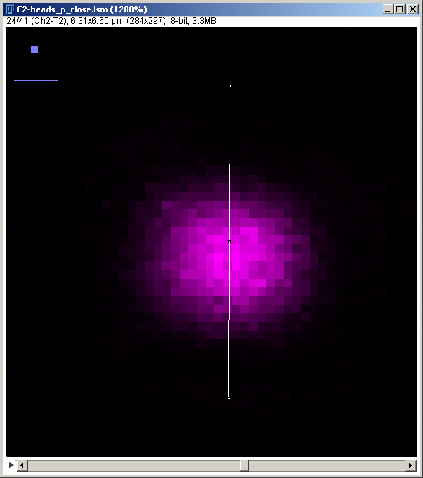
Point Spread Function Examination: Results

Slide 23
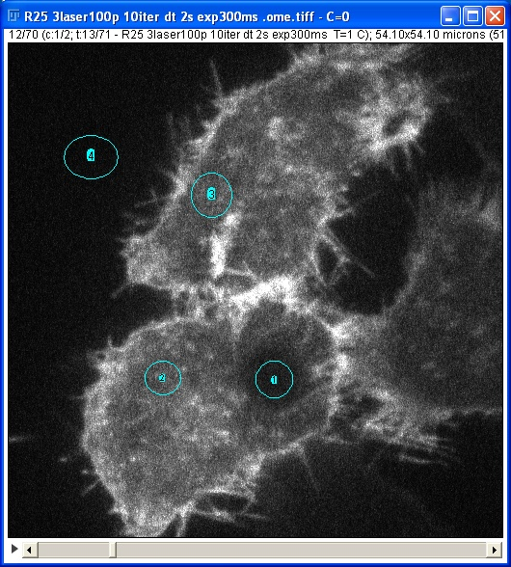
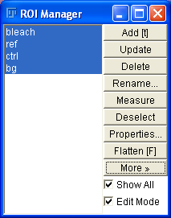
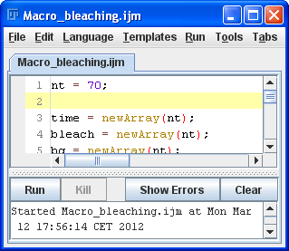
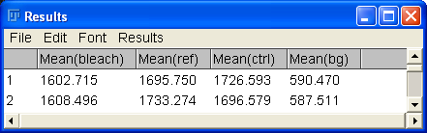
Measuring FRAP data (also uses a macro)
open all files in “../frap/” (File..Import..Image Sequence)
draw 4 regions as shown and add them to the ROI manager (Analyze..Tools..ROI Manager..Add)
Rename them (it is important that they have the exact names: bleach, ref, ctrl, bg )
Select only the “Mean Gray Value” measurement (Analyze..Set Measurements)
Select all regions and measure (ROI Manager…More>>…Multi Measure)
Open “../Macros/Macro_bleaching.ijm” (drag and drop onto FIJI) and Run the Macro
*
bg
ctrl
*
ref
bleach
*
*
bg
signal
Question: What is the recovery half-time of the signal?
(estimate it from the final graphs; dt=2s)
Optional Task: Modify the macro such that it only shows the raw bleach curve without normalizations.
Notes:
You can also load ROIs from images, if they are saved inside the image format: Example: open “../LOCI/Arf1-GFP_Golgi_FRAP.oib” and check “Display ROIs”

Slide 24
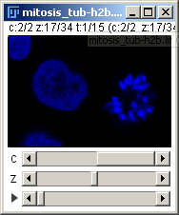
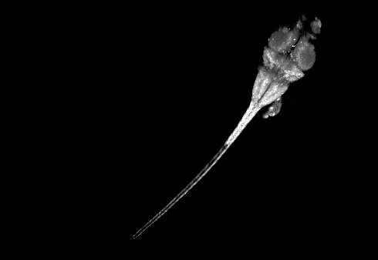
Examine 3-D data using Hyperstacks and 3-D Viewer
open “../4D/mitosis_tub-h2b.lif” as Hyperstack (Plugins..LOCI..Bioformats Importer)
examine data using Hyperstack sliders
Separate channels: Image..Color..Split Channels
Alternatively keep both channels: Image..Color..Make Composite
Select DNA channel and open volume view (Plugins..3D Viewer)
accept default values
Examine data by
Rotating (left mouse button)
Zooming (mouse wheel)
Playing the movie
Change Display Settings
Edit...Change Color
Edit...Transfer Function
Question: what do you notice when viewing chromosomes from the side?
Optional Task 1 (if your computer is strong enough…): open “../zebrafish_wholefish_neurons.tif”
and/or “../egg-chambers_3d.lsm”
make movie (3D Viewer: View..Record 360 deg rotation)
save movie (File..Save As..Avi)
Notes:
24

Slide 25
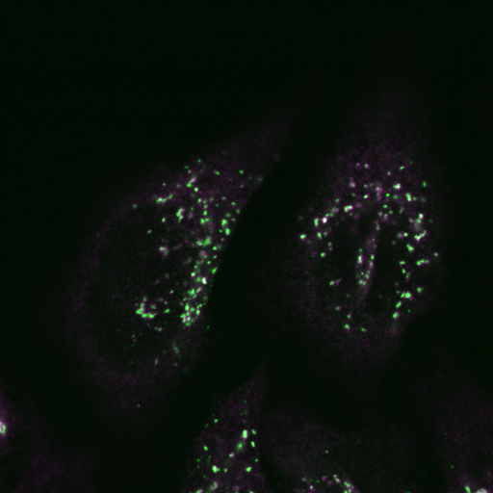
Colocalisation
One often is interested whether two proteins are localized on the same intracellular compartment.
The quantification of such “co-localization” images is not trivial and there exist many methods.
A good review is: Journal of Microscopy, Vol. 224, 2006, pp. 213–232. A guided tour into subcellular colocalization analysis in light microscopy. S. B O LT E & F. P. C O R D E L I È R E S
In the following we will only discuss pixel/object based co-localisation measurements (as these are the easiest to interpret).
HeLa cells with two proteins of the secretory pathway in conditions where the Golgi is fragmented. (Christian Schuberth, EMBL)

Slide 26
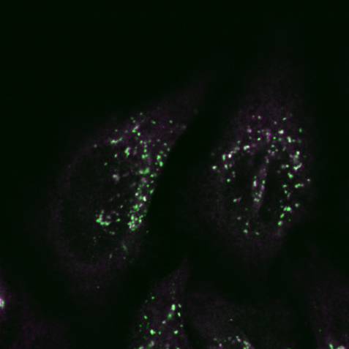
Pixel based co-localization
Open “../colocalisation/1_GalNAc-GFP” and “../colocalisation/1_AB2-COP1”
Threshold the two individual images (Image..Adjust..Threshold)
Check Dark background
Click Apply
Divide images by 255 to set object pixels to 1 (Process..Math..Divide)
Create co-localization image by multiplying the two images (Process..Image Calculator..Multiply)
Measure overlap:
Select measurement “Integrated Density” (Analyze..Set Measurements)
Measure all 3 images (Analyze..Measure)
RawIntDen gives you the number of object pixels
Divide the number of objects pixels of the overlap image by either image 1 or image 2 to get the respective co-localizations
Question 1: what is the co-localization of 1_GalNAc-GFP with 1_AB2-COP1?
Question 2: what is the co-localization of 1_AB2-COP1 with 1_GalNAc-GFP ?
Optional Task 1: also examine the images 2_GalNAc-GFP and 2_AB1-LAMP1
Optional Task 2: Create color overlay (Image..Color..Merge Channels)
Check Create Composite
Use Green and Magenta
Adjust brightness of both channels (Image..Adjust..Brightness/Contrast)

Slide 27

Image filtering
Enhance raw data
Raw data
Intensity threshold
Intensity measurements
Objects

Slide 28
White-board session on: Image filtering
Local pixel neighborhood
Mean smoothing
Gaussian smoothing
Median smoothing

Slide 29
Image filtering for improved particle detection
Open image “../noisy_nuclei/noisy_nuclei.tif”
Threshold the image [Image..Adjust..Threshold]
Detect [Analyze..Analyze Particles]
“Show: Overlay Outlines”
As you can see, this does not work very well…
Now, first smooth the image: [Process..Filters..Median] (Radius 7 pixels) and repeat the thresholding and particle detection
Optional Task 1: Work with the raw data (not smoothed) and try to improve the results with the “Size” exclusion and “Include holes” options of the Particle Analyzer.

Slide 30
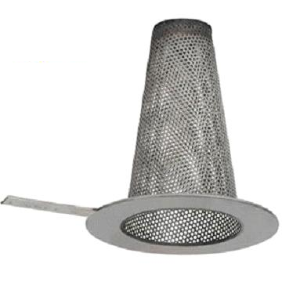
Top-hat filter
Quite advanced, but very useful as it both
enhances locally bright structures
performs a local background subtraction

Slide 31






Top-hat filter removes local background and thereby enhances locally bright structures
raw
raw & threshold
erosion (local minimum, r=7)
dilation (local maximum, r=7)
“Background”
Image
tophat = raw - dil(ero(raw))
tophat & threshold
GalNac-YFP Golgi precusors in BCS1 karyoplast (Gayathri Vegesna, EMBL Heidelberg)

Slide 32
Top-hat filtering
top-hat & threshold
Open “../top-hat/images/20X_GFP-slice51.tif”
Rename to “raw” (Image..Rename..)
Duplicate the image and call it “open” (Image..Duplicate..)
Perform an opening filter: open(raw)=dilation(erosion(raw)]
Erode the image with a minimum filter of radius 7 pixels (Process..Filters..Minimum)
Dilate the result with a maximum filter of radius 7 pixels (Process..Filters..Maximum)
Perform top-hat filter: tophat = raw-open(raw)
Subtract the opened image from the raw image (Process..Image Calculator..)
Rename the resulting image to “tophat” (Image..Rename..)
Compare thresholding vesicles in the “raw” and “tophat” image (Image..Adjust..Threshold)
Question 1: what is the difference between the raw image and the top-hat filtered image?
Question 2: what happens if the radius of the opening filter is very small (e.g. 1 pixel) (try it!)
Question 3: what happens if the radius of the opening filter is very large (e.g. 100 pixel) (try it!)

Slide 33
Distinguishing dots from lines
Draw line and dot (pixel width =3)
Plugins..Feature Extraction..FeatureJ
Hessian

Slide 34

Image segmentation (object detection) using supervised machine-learning
X
Enhance raw data
Raw data
Intensity threshold
Intensity measurements
Objects

Slide 35

Supervised machine learning
In a nutshell: The computer computes many (~100) filters on each image and learns how to combine them to find your objects of interest

Slide 36
White-board session on supervised pixel classification
Feature vectors
Labeling
Learning

Slide 37




Supervised automated pixel classification
Open “../supervised_segmentation/scanningEM_flyEye.tif”
Run [Plugins..Segmentation..Trainable Weka Segmentation]
Add labels using the freehand line tool:
mark regions on the eye [Add to class 1]
mark regions outside the eye [Add to class 2]
Try the prediction: [Train classifier]
Add more labels to regions where the prediction is not yet satisfactory
If you are satisfied export results: [Get probability]
Use thresholding [Image..Adjust..Threshold] and the particle analyzer [Analyze..Analyze Particles] to segment the eye
Trainable Segmentation
Freehand line tool

Slide 38
Stitching with flat-field correction
Open “../stitching/…”
Open “../stitching/..” **
Flat-field correction of all images:*
Smooth flat-field image [Process>Filters>Mean](radius: 5)
Measure mean intensity of the flatfield image [Analyze>Measure]
Divide all images by the smoothened flat-field: [Analyze>Tools>Calculator plus]
i1: tiles_3x3_10%overlap.lsm; i2: flatfield; k1: mean intensity of flat-field image; k2: 0
Select the result and [File>Save As>Image Sequence](Name: tile_)
Stitching of corrected images:
[Plugins>Stitching>Grid/Collection stitching](click OK)
Grid size x & y: 3
Tile overlap: 10
First file index: 0
Directory: Choose the directory where you saved the tiles
File names for tiles: tile_{iiii}.tif
* here we assume that pixel intensities in the absence of a sample are zero; if this is not the case you have to subtract the non-zero offset from all images before doing the flat-field correction.
** computing a flat-field from the tiles can be quite good (for sure better than the fluo-slide)

Slide 39



Flat-field correction
5x5 stitched raw
5x5 stitched corrected

Slide 40

Time-lapse handling and analysis

Slide 41
Time-lapse: Movie making and annotation
Open “../tracking/ TransportOfEndosomalVirus.tif”
Add time information: [Image..Stacks..Time Stamper] (dt=2s)
Save as movie: [File..Save As..AVI…] (jpeg compression)

Slide 42


Manual Tracking
Open “../tracking/ TransportOfEndosomalVirus.tif”
Start tracker: [Plugins..Tracking..Manual Tracking]
Enter scaling [Check: Show Parameters]
Time interval: 2 s
x/y calibration: 0.129 um
Track a few (e.g., 3) different particles
[Check: Use centering correction? Local Maximum]
Track particles: [Add track] click..click… [End track]
Try the different drawing options, e.g. [Overlay Dots & Lines]
Examine the results table: what are the fastest speeds that you measured?
Notes:
it is handy to magnify the movie before you start tracking
while adding tracks, click nowhere else!
velocity of Kinesin inside HeLa cells = 0.6 µm/s
a handy “trick” to see all areas visited by the vesicles is to perform a “Maximum intensity projection” [Image..Stacks..Z Project] (Maximum Intensity)

Slide 43




Kymograph Analysis
Open “../gfp_tirf_dt0.5s_dx106nm.TIF” (File..Open)
Enhance microtubules (Process..Subtract Background)
5 pixel radius (no “light background”)
Trace a dynamic microtubule (Segmented Line Tool)
Optional Trick: Make a max-projection of the movie
Change scaling to 1 pixel in x,y and z (Image..Properties)
Make Kymograph (Image..Stacks..Reslice)
Accept all default values
Task: measure one growth and one shrinkage speed of a microtubule (see example below). dx_pixel = 106 nm, dt_pixel = 0.5 s
space x
dx= -35 pixel
time t
dt= +7 pixel
Demonstrate: segmented line, save as x-y coordinates…
Notes:
Optional Task 1:
43

Slide 44

Kymograph Analysis Results
segmented line, save as x-y coordinates…

Slide 45
Automated Tracking
Kota Miura EMBL, Heidelberg
Thomas Pengo CRG, Barcelona
Christian Tischer EMBL, Heidelberg

Slide 46
White-board session on: Automated tracking
Linkage costs:
Local
Global
Distance
Morphology
Birth and death costs
Gap costs
Split and merge costs
t
t+1
t
t+1
t
t+1
t
t
t+1
t+1
t+2
t
t+1
t+2

Slide 47
Automated Tracking: Installing a Tracking Plugin
Install the “MOSAIC Particle Tracker”
Feature point tracking and trajectory analysis for video imaging in cell biology. I.F. Sbalzarini, P. Koumoutsakos, Journal of Structural Biology 151 (2005) 182–195
[Help..Update Fiji]
Click: Manage Update Sites
Check: MOSAIC ToolSuite and click Close
Click: Apply Changes
After restarting you should now have: [Plugins..Mosaic..Particle Tracker 2D/3D]

Slide 48

Automatic Tracking
Exercise
Load “../tracking/TransportOfEndosomalVirus.tif”
[Plugins..Mosaic..Particle Tracker 2D/3D]
‘Preview’ with different parameters.
Radius: Estimate of particle radius
Cutoff: “Non-particle” discrimination Percentile: Particle brightness in upper xx % of histogram
Questions:
What happens if you set the “radius” very large (e.g., 10)?
What happens if you put the “percentile” very high (e.g., 1)

Slide 49
Automatic Tracking
Displacement: maximum distance of movement between frames
Link range: number of following frames to be considered for linking

Slide 50



Automatic Tracking
Radius: 3
Cutoff: 0
Percentile: 0.6
Link range: 3
Displacement: 20
‘OK’
‘Visualize all trajectories’

Slide 51




Automatic Tracking
Try entering some values!
50
100

Slide 52


Automatic Tracking
Select a track, and then..
Click ‘Focus on Selected Trajectory’
Click ‘Focus on Area’

Slide 53

Automatic Tracking
‘All Trajectories to Table’
Excel, ImageJ Macro,
Matlab, R, …

Slide 54
Automated Tracking
and cell classification
=> Cellcognition

Slide 55
3-D visualisation
Open “../3D_segmentation/primordium.tif”
Ortho-slicing [Image..Stacks..Orthogonal views]
3D Viewer:
Start 3-D Viewer: [Plugins..3-D Viewer]
Rotate (Click and move)
Zoom (PC: mouse wheel; Mac: Two fingers)
Pan: shift-drag

Slide 56

3-D segmentation and object analysis (using supervised learning)
Open “../3D_segmentation/primordium_crop.tif”
Convert to RGB [Image..Type..RGB color]
Train the “cell” and “non-cell” classes using [Plugins..Segmentation..Trainable Weka Segmentation]
When satisfied click “Get probability”
Extract the “cell channel” (Channel 1): [Image..Stacks..Tools..Make Substack]
Smooth the probability map: [Process..Filters..Gaussian Blur…] (radius: 2 pixels)
Convert to 8bit [Image..Type..8-bit]
[Analyze>3D objects counter]
Play with the settings and output options
..3D OC options (chose the image to compute intensities on…)
Combine “Surface Map” with the raw data [Image..Color..Merge Channels]
How many cells did you find?

Slide 57
ImageJ Macros
If a certain analysis procedure consist of many steps it is convenient to “record” them and apply them automatically at once.
To do so, ImageJ Macros are a great tool

Slide 58
Tophat filtering macro
Open “../top-hat/images/20X_GFP-slice51.tif”
Turn on Macro Recorder (Plugins..Macros..Record)
Rename to “raw” (Image..Rename..)
Duplicate the image and call it “open” (Image..Duplicate..)
Perform an opening filter [open(raw)=dilation(erosion(raw)]
Erode the image with a minimum filter of radius 7 pixels (Process..Filters..Minimum)
Dilate the result with a maximum filter of radius 7 pixels (Process..Filters..Maximum)
Perform tophat filter [tophat = raw-open(raw)]
Subtract opened image from raw image (Process..Image Calculator..)
In the Macro Recorder click Create and clean up the code to look like this:
rename("raw");
run("Duplicate...", "title=open");
run("Minimum...", "radius=7");
run("Maximum...", "radius=7");
imageCalculator("Subtract create", "raw",“open");
Open “../top-hat/images/20X_GFP-slice51.tif”
Execute your macro (In the macro window: Run..Run)

Slide 59
Batch Analysis
Often you want to apply the same sequence of analysis steps to a bunch of different images: this is called “Batch Analysis”
In the following, we will explore some ways how to do this in ImageJ

Slide 60
Batch analysis using macros: Top-hat filtering of many images
Open: [Process..Batch..Macro]
As input choose: “..Macros\batch_tophat\input_data\ “
As output choose: “..Macros\batch_tophat\output_data\ “
Copy and paste the top-hat macro code
Run it by clicking: Process
Inspect the output folder

Slide 61
Batch analysis using image stacks: Top-hat filtering
Many ImageJ commands work on stacks; so an alternative workflow for batch-processing of many images can be
load all your images via “File..Import..Image Sequence”
perform the image processing on the image stack
Save to individual files via “File..Save As..Image Sequence”
For instance, try the top-hat filtering on the images in “..Macros\batch_tophat\input_data\”

Slide 63
Things to add:
Deconvolution?
Is it intensity preserving?
Stackreg
Try on a mitocheck movie
Sum and Max Projection
What would be good data?
Advanced Intensity quantification
Get the DNA damage data from the woman in the Copenhagen course
Macro programming:
To the top-hat macro, add:
Variable for radius
Get User input from GUI
Particle Analyzer

